Slide 1

Volatility Prediction using Financial Disclosures Sentiments with Word Embedding-based IR Models
廖庆文
2018/01/25

Slide 2
Introduction
Related Work
Methodology
Experiments and Results
Conclusion

Slide 3
Introduction
Volatility forecasting has gained considerable attention during the last three decades. In addition to using historic stock prices, new methods in this domain use sentiment analysis to exploit various text resources——annual report
long, redundant, and written in a style， They suggest that only the risk factors topic appears to be useful and informative to investors
this paper shows that state-of-the-art Information Retrieval (IR) term weighting models, which benefit from word embedding information, have a significantly positive impact on prediction accuracy.

Slide 4
Related Work
Kazemian et al. (2014) use sentiment analysis for predicting stock price movements in a simulated security trading system using news data
Ding et al. (2015) address a similar objective while using deep learning to extract and learn events in the news.
Luss et al. (2015) also exploit news in combination with return prices to predict intra-day price movements. They use the Multi Kernel Learning (MKL) algorithm for combining the two features.
Kogan et al. (2009) use a linear Support Vector Machine (SVM) algorithm on the reports published between 1996–2006.
Tsai and Wang (2014) improve upon this by using the Loughran and McDonald (2011) Lexicon and using word embedding to expand the financial lexicon, observing improvement in the prediction.

Slide 5
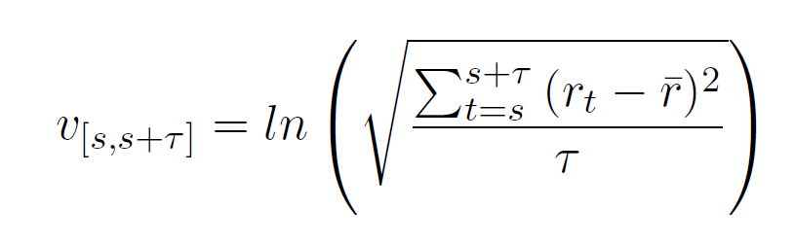

Methodology
volatility is defined as the natural log of the standard deviation of (adjusted) return prices in a window of τ days.
rt is the return price
rt = ln(Pt)−ln(Pt−1),
as the volatility of the stock of the reporting company in the kth quarter-sized window starting from the issue date of the report si

Slide 6
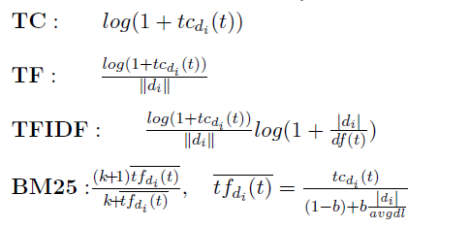
Methodology
Sentiment Analysis
we extract the keyword set from a finance-specific lexicon using the positive, negative, and uncertain groups, stemmed using the Porter stemmer Lex
expanded this set by adding the top 20 related terms to each term to the original set. The related terms are obtained using the Word2Vec model LexExt

Slide 7

Methodology
Sentiment Analysis
3. we use state-of-the-art weighting methods in Information Retrieval (Rekabsaz et al., 2016b)
which benefit directly from word embedding models
4. The feature vector generated by the weights of the Lex or LexExt lexicons is highly sparse, We therefore reduce the dimensions by applying Principle Component Analysis

Slide 8
Methodology
Market Features
Current Volatility is calculated on the window of one quartile before the issue date of the report v[si−64,si].
Volatility of future quarters GARCH (Bollerslev, 1986) is a common econometric time-series model used for predicting stock price.
Sector The feature is converted to numerical representation using one-hot encoding.

Slide 9
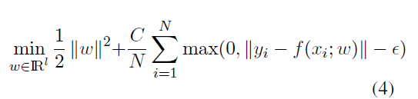
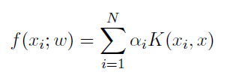
Methodology
Feature Fusion
early fusion. simply joining all the features in one feature space.
late fusion approaches first learn a model on each feature set and then use/learn a meta model to combine their results
we use stacking (Wolpert, 1992), a special case of late fusion.
Split the training set into two parts(70% - 30%)
train separate machine learning models for each of the text and market feature sets.
Finally train another model to capture the combinations between the outputs of the base models
the final model is always trained with SVR with RBF kernel

Slide 10

Methodology
Feature Fusion
Stacking => suffer from lack of training data
A potential approach to learn both the feature sets in one model is the MKL method.
We use the mklaren method (Straˇzar and Curk, 2016) which has linear complexity in the number of data instances and kernels.

Slide 11
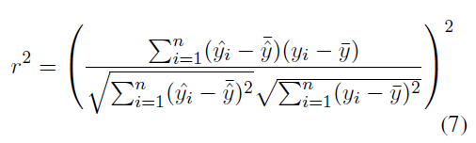
Experiments and Results
1
Dataset
the reports of companies of the U.S. stock markets from 2006 to 2015, We extract the Risk Factors section using term matching heuristics.
the stock prices, collected from the Yahoo website.
2
Baselines
GARCH
Market
Wang et al. (2013)
Tsai et al. (2014)
3
Evaluation Metrics

Slide 12
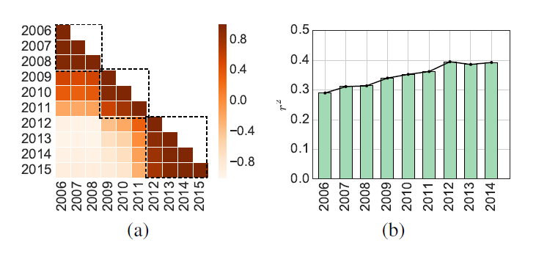
Experiments and Results
Content Analysis of 10-K Reports
This subset is also the most recent cluster and presumably more similar to the future reports. Therefore, in the following, we only use this subset, which consists of 3892 reports, belonging to 1323 companies

Slide 13
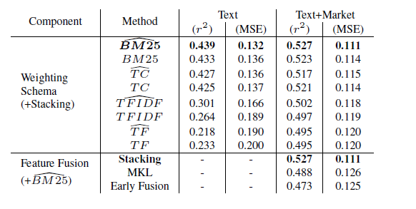
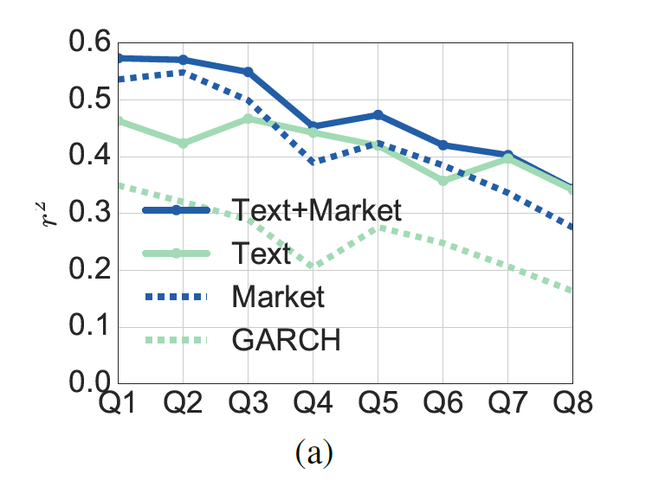
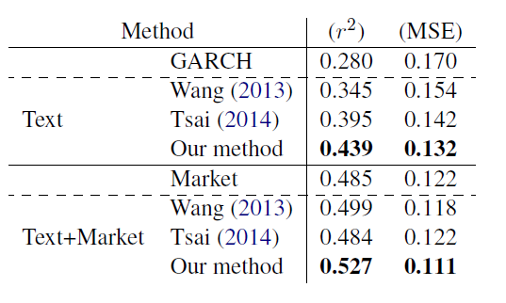
Experiments and Results
Volatility Prediction

Slide 14
PPT模板下载：www.1ppt.com/moban/ 行业PPT模板：www.1ppt.com/hangye/
节日PPT模板：www.1ppt.com/jieri/ PPT素材下载：www.1ppt.com/sucai/
PPT背景图片：www.1ppt.com/beijing/ PPT图表下载：www.1ppt.com/tubiao/
优秀PPT下载：www.1ppt.com/xiazai/ PPT教程： www.1ppt.com/powerpoint/
Word教程： www.1ppt.com/word/ Excel教程：www.1ppt.com/excel/
资料下载：www.1ppt.com/ziliao/ PPT课件下载：www.1ppt.com/kejian/
范文下载：www.1ppt.com/fanwen/ 试卷下载：www.1ppt.com/shiti/
教案下载：www.1ppt.com/jiaoan/ PPT论坛：www.1ppt.cn
Thank You
Notes:
volatility.GARCH（Bollerslev，1986）是用于预测股票价格波动的常用计量经济学时间序列模型。

